Slide 1
Application of Basis in Machine Learning
Hung-yi Lee

Slide 2
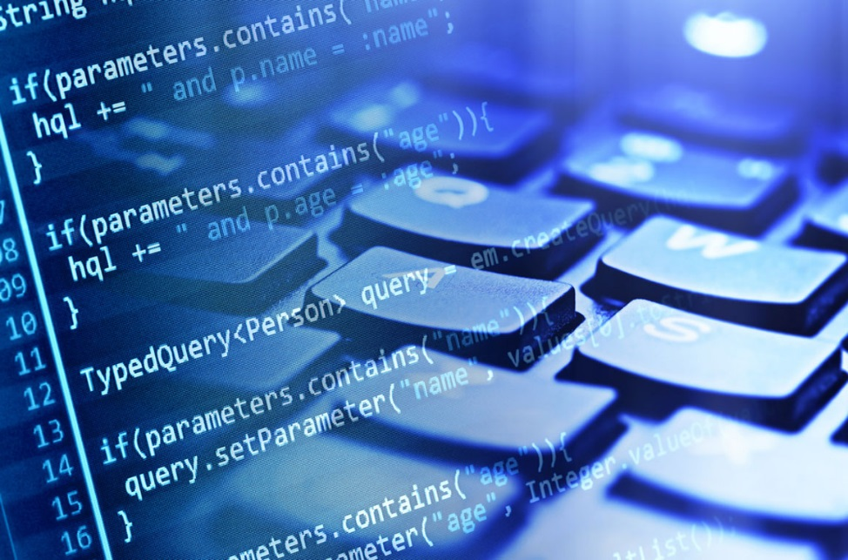
What is Machine Learning?
You can ask computers to do lots of things for you.
However, computer can only do what you ask it to do.
Computer can never solve the problem you can’t solve.

Slide 3
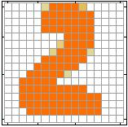
Example: Handwriting Digit Recognition
One day, you are asked to write a program for handwriting digit recognition.
Machine
“2”
“1”:
……
Hard to describe the common pattern by rules
“2”:
……
Lots of exception.
Notes:
“Hello world” for deep learning
Data: http://yann.lecun.com/exdb/mnist/

Slide 4
Example: Handwriting Digit Recognition
Write a program for learning, and then teach the machine by some examples.
“2”
“5”
“9”
“0”
“4”
“1”
“2”
“1”
“3”

Slide 5
Example: Handwriting Digit Recognition
What a machine see are pixels
Can we make the input simpler?
……
vector
16 x 16 = 256
Ink → 1
No ink → 0

Slide 6

Example: Handwriting Digit Recognition
$$\left[\begin{aligned}c_{1} \\ c_{2} \\ ⋮ \\ c_{n}\end{aligned}\right]$$
$$x=c_{1}u_{1}+c_{2}u_{2}+⋯+c_{n}u_{n}$$
Represent a digit image
Pixels in a digit image
(coordinate change)
Basis for digit images
If there are 16 X 16 pixels in an image, it is very possible that n is less than 16 x 16
A random 16 x 16 image is not a digit.
The dimension of the subspace of Handwriting Digits is much less than 256

Slide 7
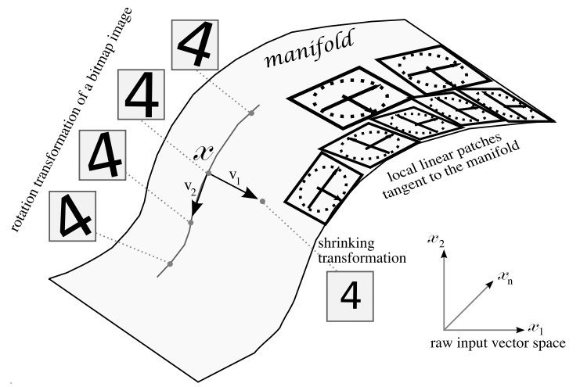
Example: Handwriting Digit Recognition

Slide 8
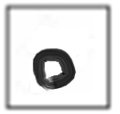
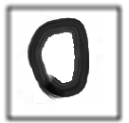
Example: Handwriting Digit Recognition
$$x=c_{1}u_{1}+c_{2}u_{2}+⋯+c_{n}u_{n}$$
…….
u₁
u₂
u₃
u₄
u₅
16
u₁
u₃
u₅
16
=
+
+
Represented by
16 X 16 = 256 pixels
[1 0 1 0 1 0 …….]
(simpler representation)
Notes:
Basis ……

Slide 9
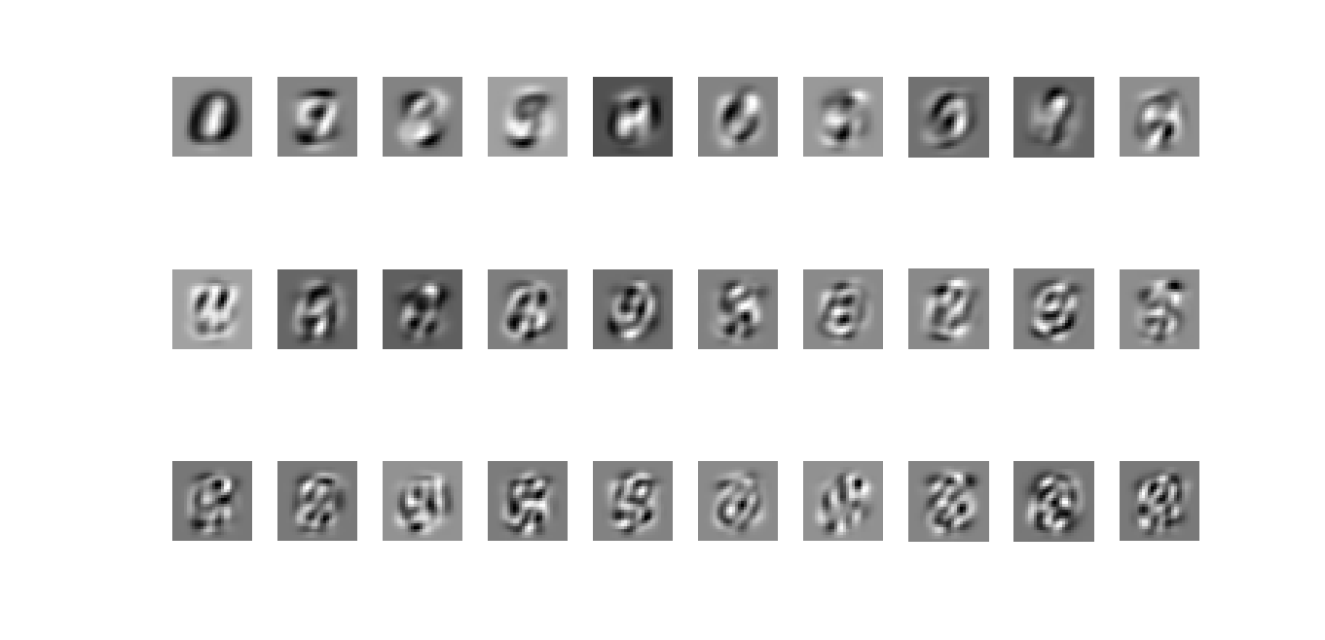
PCA (Chapter 7.8 in textbook)

Slide 10
NMF
(strictly speaking, they do not form a basis)
Notes:
http://www2.imm.dtu.dk/projects/spasm/references/spasm.pdf

Slide 11
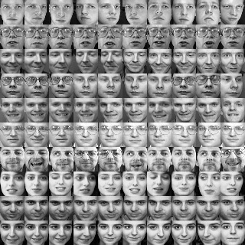
Face Recognition
A
B

Slide 12
PCA (Chapter 7.8 in textbook)

Slide 13
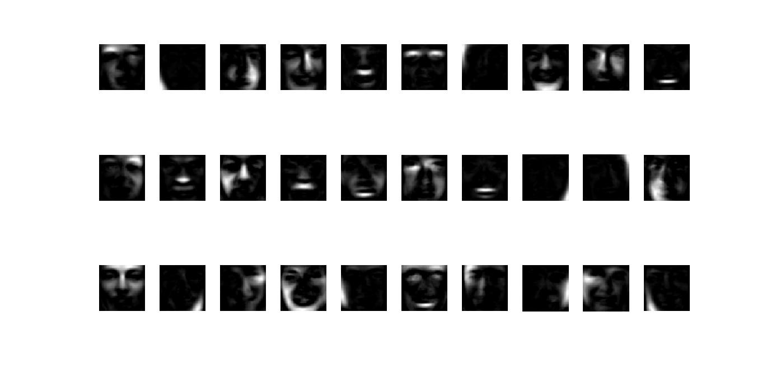
NMF
(strictly speaking, they do not form a basis)
Notes:
reshape(W(:,i)

